Slide 1
Inverse Kinematics
2018/05/17

Slide 2
Understand the principle of IK and apply it to satisfy specified constraints
mapping from Cartesian space to joint space
compute joint angles to place the end effector to the desired positions

Slide 3
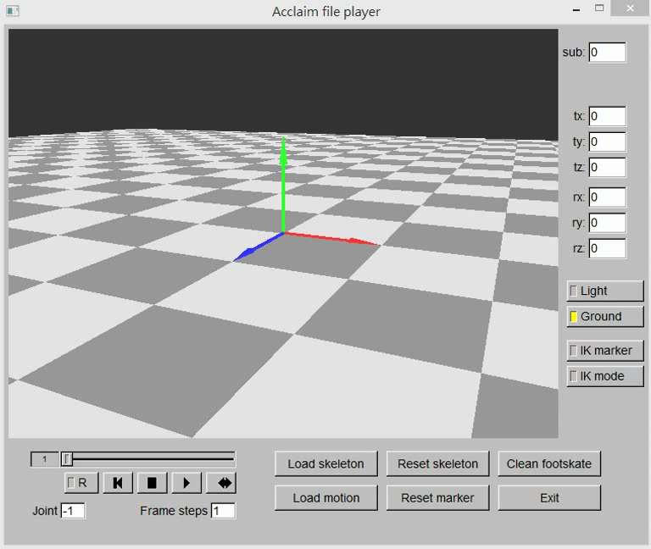
Demo

Slide 4
Environment
Windows 10
Microsoft Visual Studio Professional 2013
Third party
fltk: gui
Eigen: matrix operations
boost: useful utilities beyond STL

Slide 5
System Overview
The same framework of assignment 2
Include forward kinematics library

Slide 6

math Module
math::MatrixN_t
a dynamic-size matrix
math::VectorNd_t
a dynamic-size column vector
dynamic size object need allocation first
math::MatrixN_t mat(10, 15) mat is a 10 $×$ 15 matrix, with allocated but uninitiallized coefficients

Slide 7
Inverse Kinematics
mapping from cartesian space to joint space
Review “Kinematics.ppt” from p.21-p.58

Slide 8
Solving Inverse Kinematics
Analytic method
Inverse-Jacobian method
Optimization-based method
Example-based method

Slide 9

Inverse-Jacobian method
Jacobian maps velocities in joint space to velocities in cartesian space
$f\left(θ\right)=p$
$\frac{dp}{dt}=\frac{∂f(θ)}{∂θ}\frac{dθ}{dt}=J(θ)\frac{dθ}{dt}$
$J\left(θ\right)\dot{θ}=V$
$$J_{ij}=\frac{∂f_{i}}{∂θ_{j}}$$

Slide 10




Computing Jacobian
Take geometric approach to compute it
You will need result of FK computation
Review “Kinematics.ppt” from p.40-p.47
$$p$$
$$\frac{∂p}{θ_{1}}=\left[\begin{aligned}\frac{∂p_{x}}{∂θ_{1}} \\ \frac{∂p_{y}}{∂θ_{1}}\end{aligned}\right]=a_{1}×(p−r_{1})$$
unit-length rotation
axis vector
$$a_{1}=\frac{ω_{1}}{\left|ω_{1}\right|}$$
$$θ_{1}$$

Slide 11






Rotational DOFs
$$p$$
$$\frac{∂p}{∂θ_{i}}$$
$\frac{∂p}{∂θ_{i}}=a_{i}×(p−r_{i})$
$a_{i}$: unit length rotation axis in world space
$r_{i}$: position of joint pivot in world space
$p:$ end effector position in world space
$$p−r_{i}$$
$$r_{i}$$
$$a_{i}$$

Slide 12




Iterative IK using Inverse Jacobian
$$P$$
$$P+dP$$
$$P_{goal}$$
$$θ=f^{−1}\left(P\right)$$
$$V=J\left(θ\right)\dot{θ}$$
$$\dot{θ}=J^{−1}\left(θ\right)V$$
$$θ_{k+1}=θ_{k}+∆tJ^{−1}\left(θ_{k}\right)V$$

Slide 13
What need to do
Finish the methods in ‘kinematics_inverse_jacobian_ik_solver.cpp’
Search “TO DO”
Test <start_bone_idx> with 25(arm) and 11(upperback)
Test specified target(x = -1.0, y = 1.49, z = -1.5)

Slide 14
InverseJacobianIkSolver::Solve Parameters
target_pos
the target position of end-effector
start_bone_idx/end_bone_idx
specify the bones used to reach target position
Default value is rhumerus/rhand
original_whole_body_joint_pos6d
motion data of the reference pose

Slide 15

InverseJacobianIkSolver Configuration
skeleton
the loaded skeleton, applied to forward kinematics
linear_system_solver
solver of$\dot{θ}= J^{−1}\left(θ\right)V$, applied to solve inverse Jacobian
step
linearization step t
$θ_{k+1}=θ+ ∆t J^{−1}\left(θ_{k}\right)V$ (p.43)
distance_epsilon
the desired tolerance of the distance b/t the target position &end-effector
max_iteration_num
the maximum allowable iterations to solve IK

Slide 16

Pseudoinverse Method
Given a linear system$J ∆θ=e$
The pseudoinverse $J^{+}$ set $∆θ$ equal to $∆θ=J^{+}e$

Slide 17

What to Do
Implement $\dot{θ}= J^{−1}\left(θ\right)V$
math::PseudoinverseSolver::Solve
Input
coef_mat $J\left(θ\right)$ (p.43)
desired_vector V (p.43)
Output
$\dot{θ}= J^{−1}\left(θ\right)V$ (p.43)

Slide 18
Configuration File
See inverse_kinematics_config.xml for options

Slide 19
Grading
Inverse kinematics 80%
Pseudoinverse method 20%
related implementations 60%
Report 30%

Slide 20
Suggested Outline of Report
Introduction/Motivation
Fundamentals
Implementation
Result & Discussion
Conclusion

Slide 21
Report Requirement
Discussion of iterative IK
effects of step, distance_epsilon, etc.
Discussion of jacobian matrix at specified target(x = -1.0, y = 1.49, z = -1.5)
-difference between starting from arm(id = 25) and lowerback (id = 11)

Slide 22
Submission
Compress all materials into a zip file
ensure your solution could be built successfully
naming rule: CA3_ID_Version e.g., CA3_1234567_v01.zip
Your zip file shall contain
source code (without boost & Eigen)
report in pdf or MS word format, no more than 10 pages
Upload to E3
no limit to the no. of times you can upload
the latest version is your final submission

Slide 23
Deadline
Sunday, 06/03 ,11:59 PM
The earlier your start, the more chances you have…

Slide 24
Late and Cheating
Late policies
Penalty of 10 points of the value of the assignment/day
Cheating policies
0 points for any cheating on assignments
Allowing another student to examine your code is also considered as cheating

Slide 25
You can find TA in…
Email:
liou8308@gmail.com
Lab EC229B
Need appointment
Please briefly mention your question when you contact me

